Slide 1
Project Title: Capturing ESD assurance criteria on the DCS
Charter Template
Business Case/objectives:
As part of the assurance criteria for executing the 6 monthly ESD tests, valve response times and closure/opening status are required to be documented. Okoloma has about 150 safety critical valves (shutdown & blowdown valves) and as such, recording the criteria for these valves are almost impossible as no valve response capture was configured on the DCS. This would also require human intervention to physically monitor and record the values. This has been a recurring finding in the 6M ESD tests carried out and the recommendation is to install a valve time mapping in the DCS.
Typically, the system architecture that supports this feature will have limit switches installed on all the valves in the field for status feedback and each switch costs $172.03 with SAP material no. 1000267781 which translates to $25,801.5 being the cost of 150 limit switches. Also a vendor will be required on site for configuration and implementation. Cost of vendor mobilisation to site is around $4,000 from agreement no. 4610043736 (service line 31796810)for a 4day site visit. Total implementation will cost circa $29,801.5.
Currently, the installed hardware for Okoloma are valve positioners in which the status (open/close) of the valves are visible on the DCS via multiplexers. This project aims at configuring the available feedback to provide the assurance criteria on the Delta V DCS system (Response time and closure status). Project will be DIY using in-house intellectual resources.
Potential Benefits & Measurement:
Man-hour savings of 13 hours
Elimination of Human error in the capture of valve response time
Overview of performance of all valves
100% compliance to integrity assurance criteria
Project Scope/Actions :
Feasibility studies
Sample implementation (using a single SDV to test)
Secure MoC approval
Full implementation on control studio
Testing during the next ESD test.
Measurement
1) Satisfactory performance of the next ESD test by the verification team
Critical Success Factors:
Feasibility of project
Vendor expertise
High-level Timeline:
L0-L1: (See definition of L1 – L5 in the next slide)
L2: May 2018
L3: June 2018
L4: August 2018
L5: December 2018
Initiative End

Slide 2
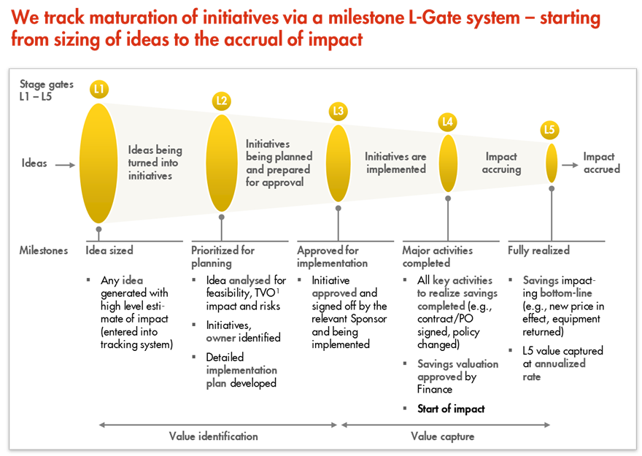
L1 – L5 Gates

